Slide 1
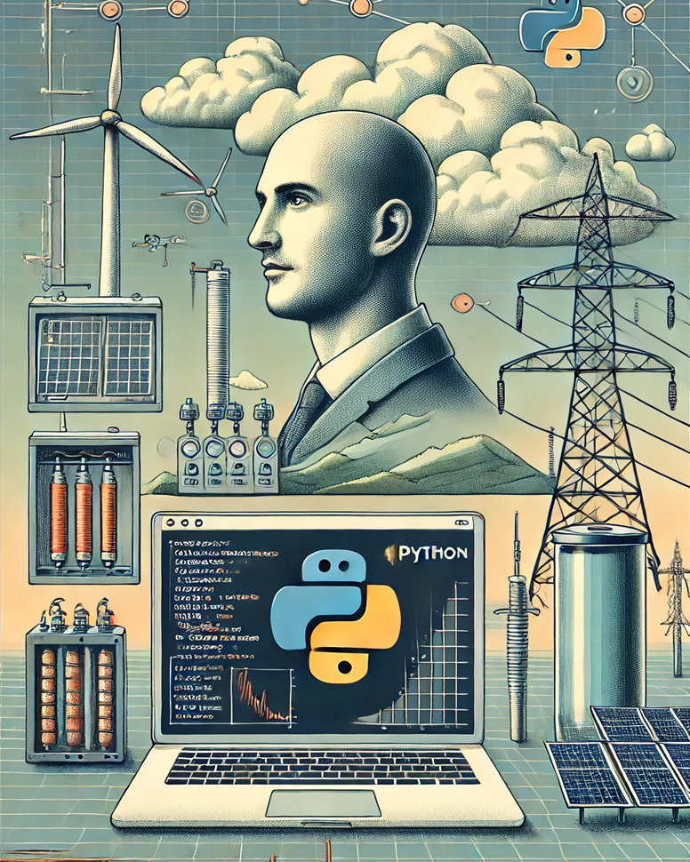

April 5, 2025
Python for Energy System Modelling
Python-Nairobi

Slide 2


Chrispine Tinega
Embedded Systems Engineer specialising in IoT for energy systems.
Driven by a passion for leveraging technology to address real-world energy challenges.
Mentor and speaker with hands-on experience in smart mini-grids and energy management systems.
https://chrispinetinega.com

Slide 3
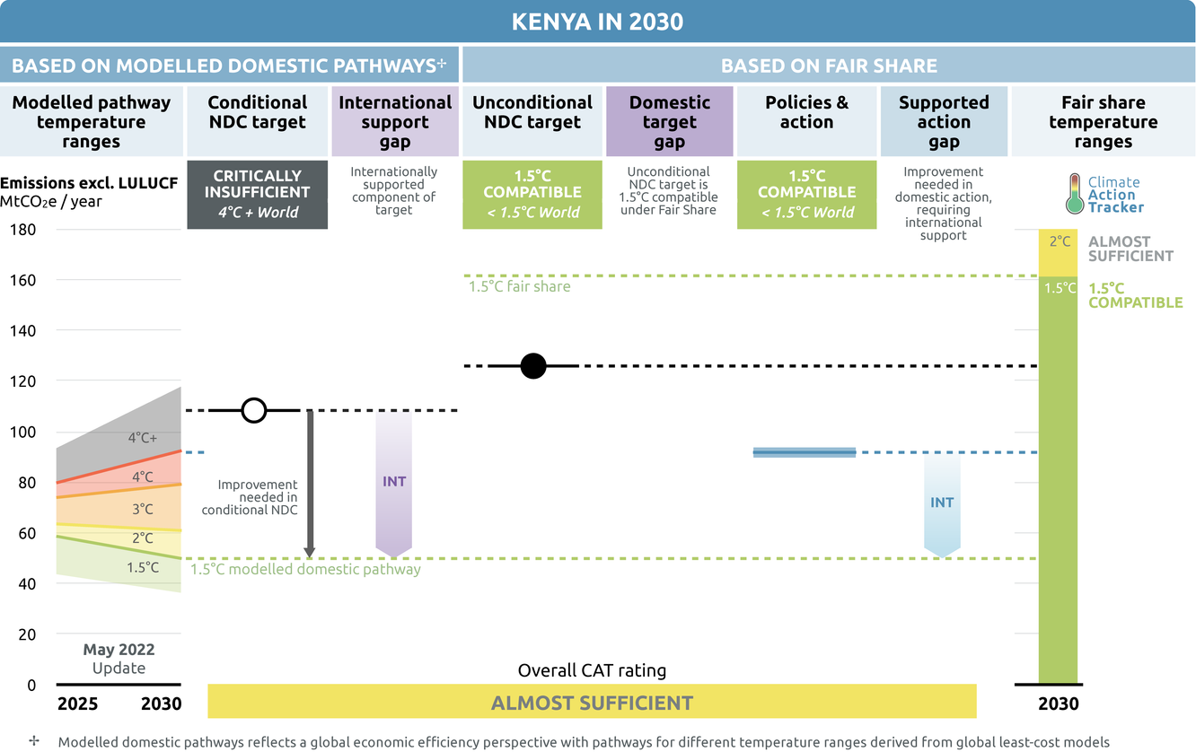
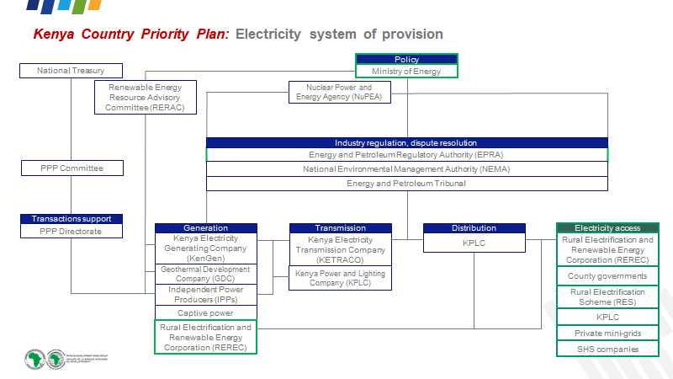
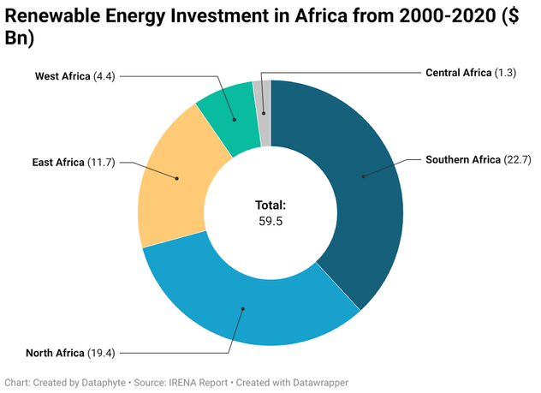

Energy Transition, Huddle?
“Kenya's energy transition faces infrastructure and funding challenges.” -Energy Transition and Investment Plan (ETIP)
Policies & action. (n.d.). Climateactiontracker.Org. Retrieved 4 April 2025, from https://climateactiontracker.org/countries/kenya/policies-action/
Policies & action. (n.d.). Climateactiontracker.Org. Retrieved 4 April 2025, from https://climateactiontracker.org/countries/kenya/policies-action/
Tackling the Challenges of Nigeria’s Energy Transition Plan. (n.d.). Thisdaylive.Com. Retrieved 4 April 2025, from https://www.thisdaylive.com/index.php/2023/01/03/tackling-the-challenges-of-nigerias-energy-transition-plan/
3
Notes:
This absence of contextual learning can lead to decreased motivation and higher dropout rates among programming students.
Factors such as low learning motivation, lack of interest in the subject, and inadequate course design have been linked to increased dropout rates in computer programming courses.

Slide 4
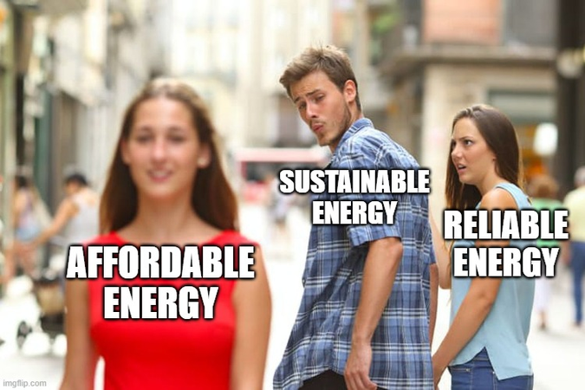
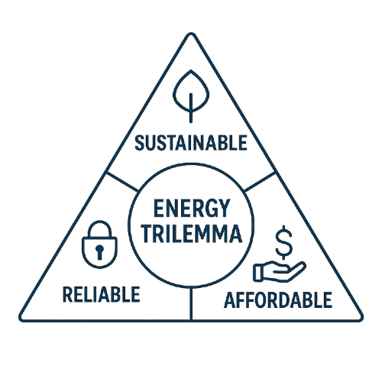

The Energy Trilemma
Sustainable - climate change. Decarbonisation
→ integrating RE, e.g., solar, wind
Reliable - grid stability, balance demand and supply
→ VRE, flexible demand, infrastructure
Affordable - investments and operational costs
→ Optimising investments and operations
Need for tools: complexity, optimisation, planning
Notes:
Simultaneously, we need to balance
-> sustainability
-> Reliability
-> Affordability
Reliability – the first priority – adequate capacity
• Investment – right plant in right place at right time
• Least (system) cost dispatch

Slide 5

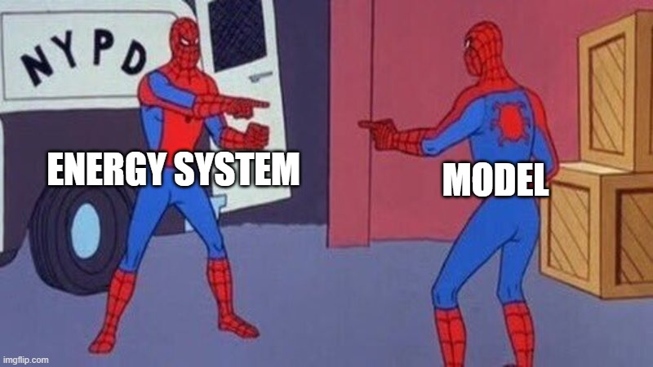
Energy System Modelling (ESM)
ESM is the process of creating simplified, computer-based representations (models) of energy systems.
Purpose
Understanding complexity, decision support and addressing the trilemma
Creating Digital Twins for Energy Systems
Inputs
Technical data, economic data, demand data, resource data, policy data
Outputs
Optimal generation mix, investment decisions, operational schedules, energy flows, systems emissions, system costs, marginal prices
Notes:
Typical Questions ESM Answers:
What is the cheapest way to meet electricity demand while achieving a certain renewable energy target?
How much energy storage is needed to balance wind and solar generation?
Where should new transmission lines be built to reduce grid congestion?
How will electrifying transport or heating impact the power grid?
What are the system costs and emissions under different policy scenarios?
_______________________
Need for simulation and optimisation tools

Slide 6

















Why Python for ESM
EMS is data-heavy (time series, geospatial, economic)
Large ecosystem (libraries: Numpy, Pandas, PyPSA, etc.)
Open source and collaborative
“Glue language”: flexibility and integration.
Community support (e.g., Python Nairobi)
Rapid prototyping, readable syntax
Notes:
Key Python Libraries:
PyPSA (Python for Power System Analysis): An open-source toolbox for simulating and optimizing modern power and energy systems. ​
oemof (Open Energy Modelling Framework): A Python toolbox for energy system modeling and optimization.
pvlib: A library for simulating the performance of photovoltaic energy systems. ​

Slide 7
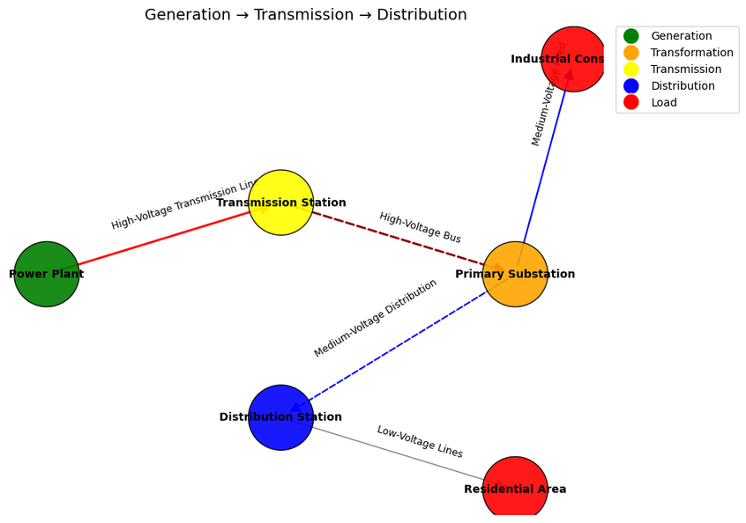
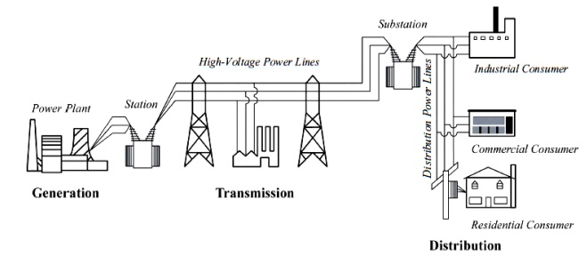

Components
Energy Systems Refresher
Generators: Produce energy, e.g., solar, wind, gas, hydro.
Max capacity (MW), cost (to build & run), efficiency, availability (especially for renewables), emissions.
Loads: Consume energy, e.g., cities, factories, residential areas.
Energy demand profile
Network: Transports energy. The grid infrastructure. Consists of:
Buses (Nodes): Connection points where components meet (like electrical substations or junctions).
Lines & Transformers (Links): Carry power between buses.
Capacity, length, voltage, impedance.
Storage: Shifts energy in time, e.g., batteries, pumped hydro storage.
Energy capacity (MWh), power capacity (MW for charging/discharging), efficiency.
7
BiNus Library | bab2BMC20150034
Notes:
Energy systems encompass the technologies and processes used to produce, distribute, and consume energy.

Slide 8
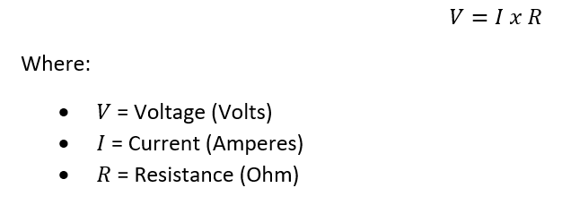
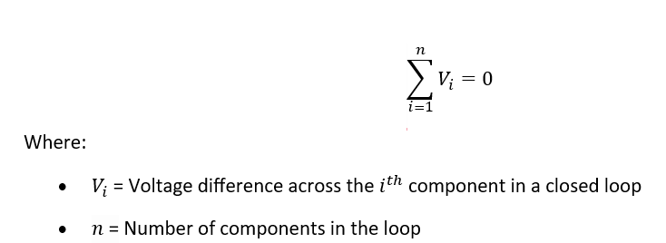
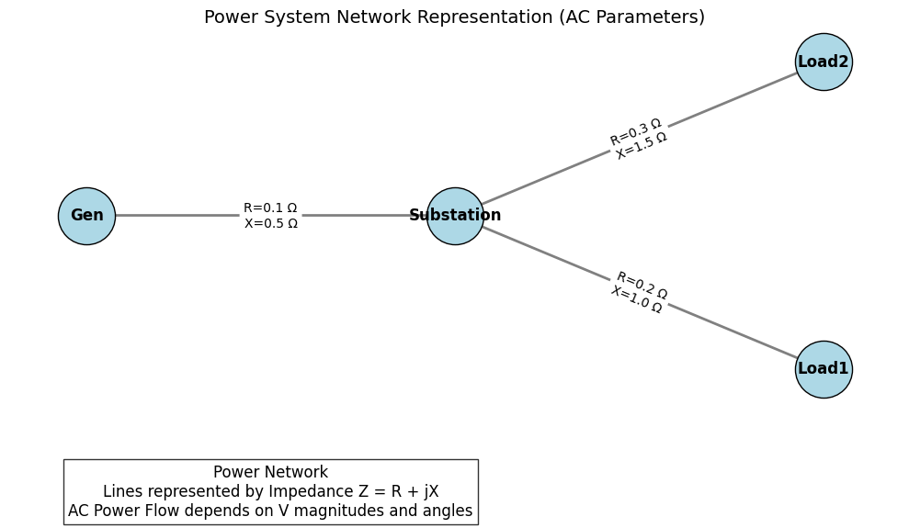
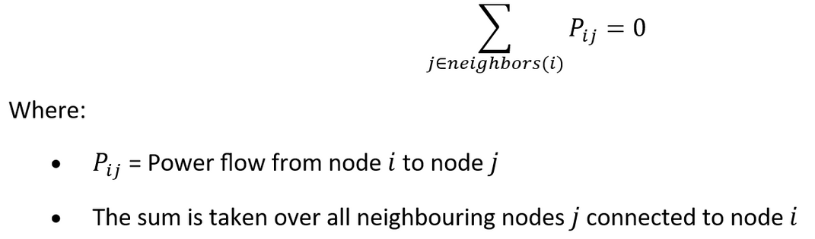

Physics of Flows
Ohm’s Law
Energy Systems Refresher
Kirchhoff’s Voltage Law (KVL)
Kirchhoff’s Current Law (KCL)
8
Notes:
Kirchhoff’s Voltage Law (KVL): The sum of voltage differences across edges for any closed cycle must add up to zero
Kirchhoff’s Current Law (KCL): The algebraic sum of all currents (or power flows) entering and leaving a node must equal zero.

Slide 9

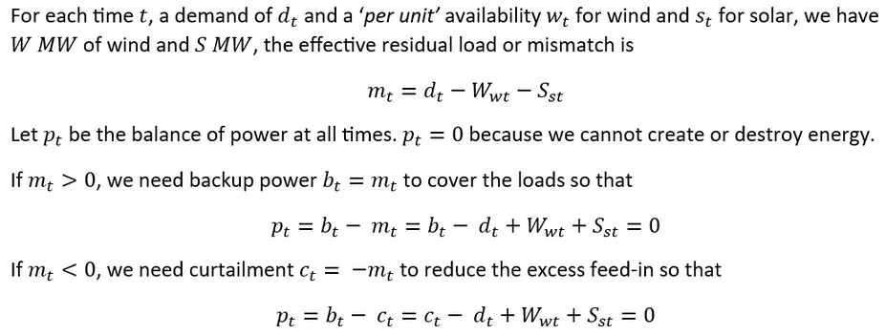
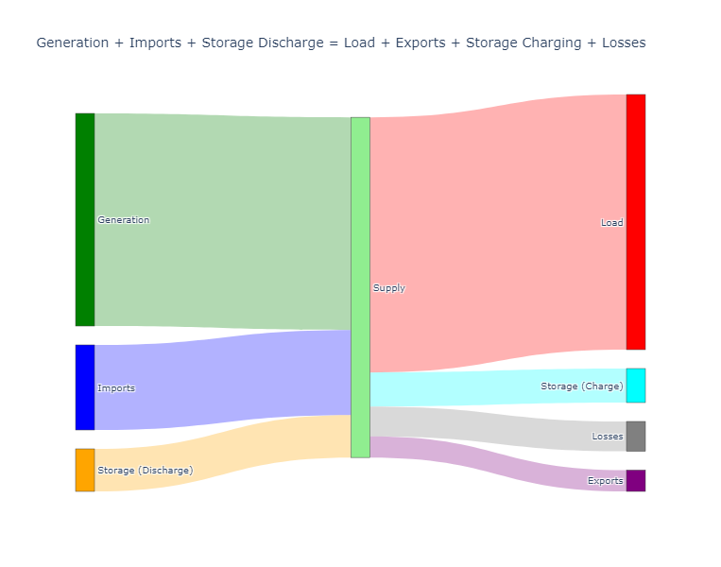
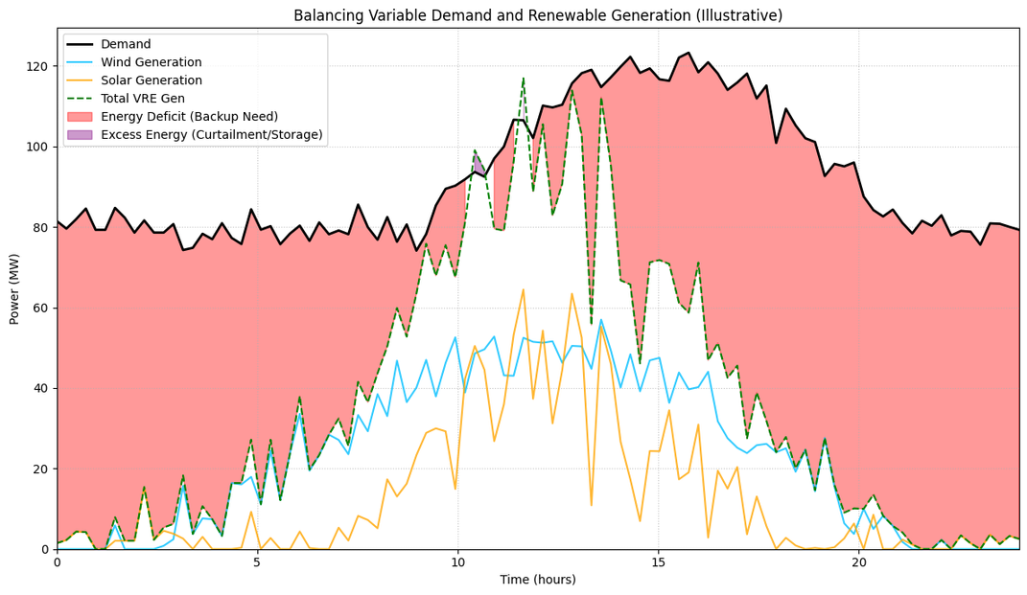
Energy Balance
Energy Systems Refresher
At every bus and at every moment in time: Energy In = Energy Out.
9

Slide 10
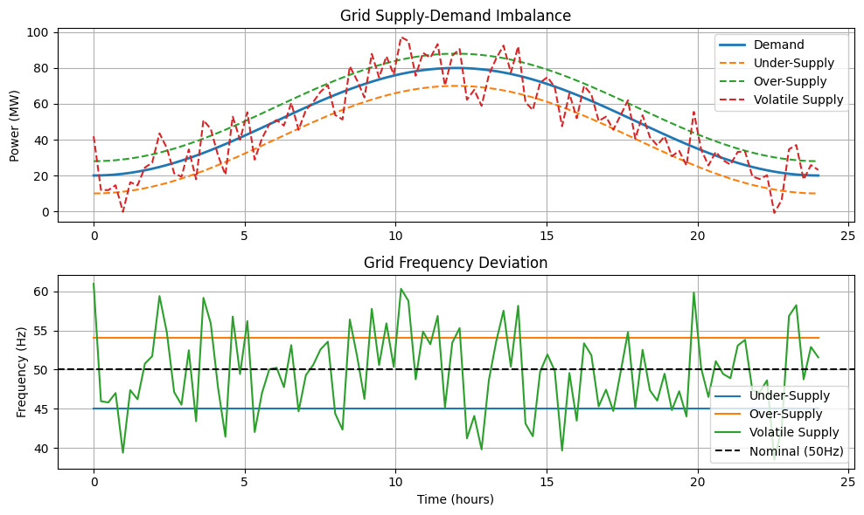
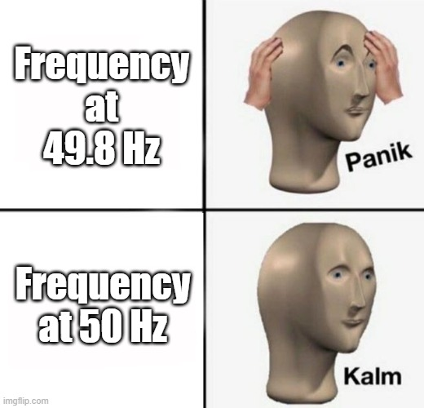
Energy Balance
Energy Systems Refresher
If supply ≠ demand => frequency deviations
Δf ∝ ΔP / H
10
Notes:
The nominal frequency (e.g., 50 Hz or 60 Hz) must be maintained in AC power systems.
Over-generation causes frequency to increase; under-generation causes frequency to decrease
Δf ∝ ΔP/H
Δf = Frequency deviation
ΔP = Power imbalance
H = System inertia
Mitigation Strategies:
Frequency Regulation: Automated response from generators or energy storage to adjust output.
Demand Response: Adjusting consumption to match generation.
Spinning Reserves: Standby generators that quickly respond to balance fluctuations.

Slide 11

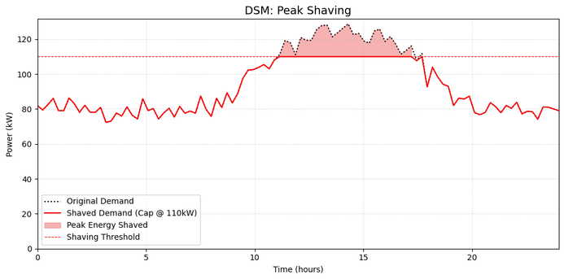
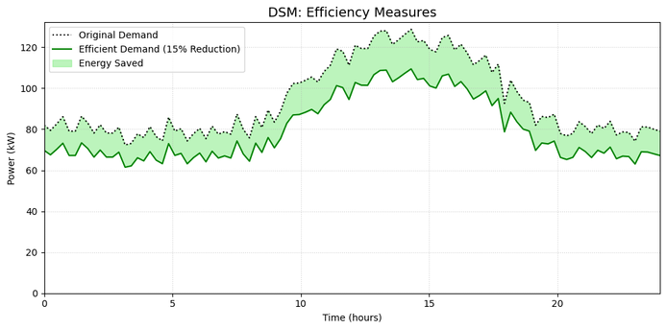
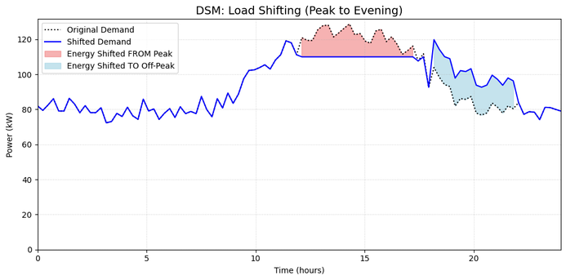

Dynamics & Variability
Energy Systems Refresher
Demand-Side Management (DSM): aims to optimise energy usage by adjusting the demand rather than increasing supply.
Load Shifting: Moving energy use from peak times to off-peak periods.
Efficiency Measures: Reducing overall energy consumption without impacting performance.
.
Peak Shaving: Minimising the highest peaks in energy demand.
Images for illustration generated by a Python script
11
Notes:
Load Shifting:
Moving energy use from peak times to off-peak periods.
Balances demand, reduces strain on the grid, and lowers costs.
_______________
Efficiency Measures:
Reducing overall energy consumption without impacting performance.
Incorporates energy-efficient appliances, retrofits, and smarter usage practices.
_____________
Peak Shaving:
Minimising the highest peaks in energy demand.
Reduces the need for additional backup power and lowers operational costs.

Slide 12
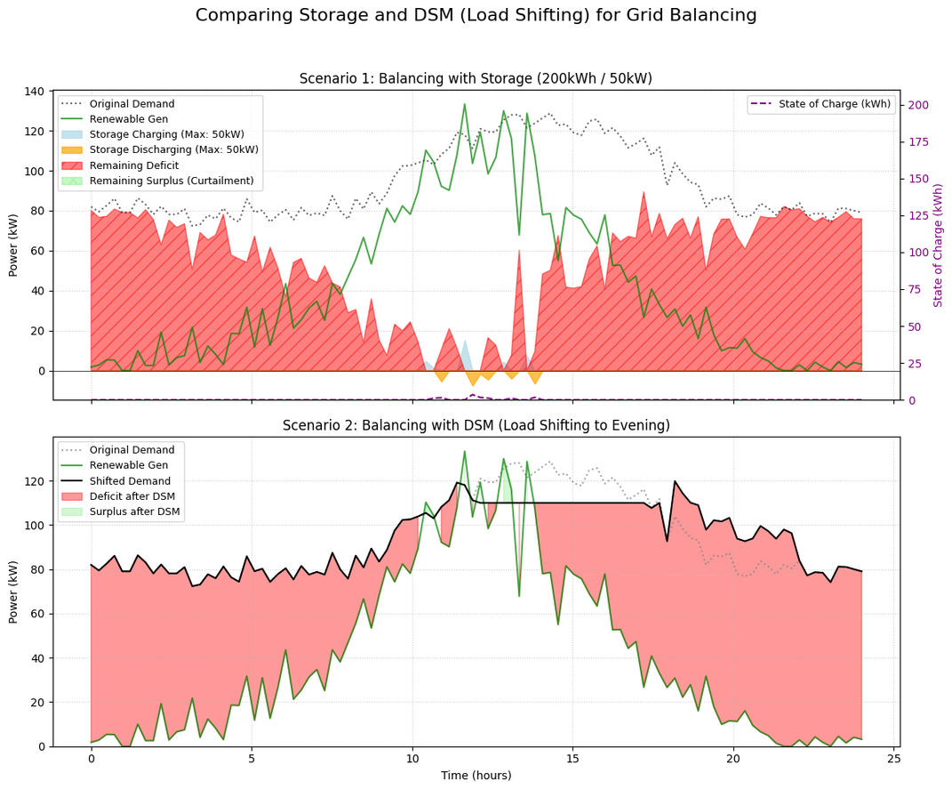
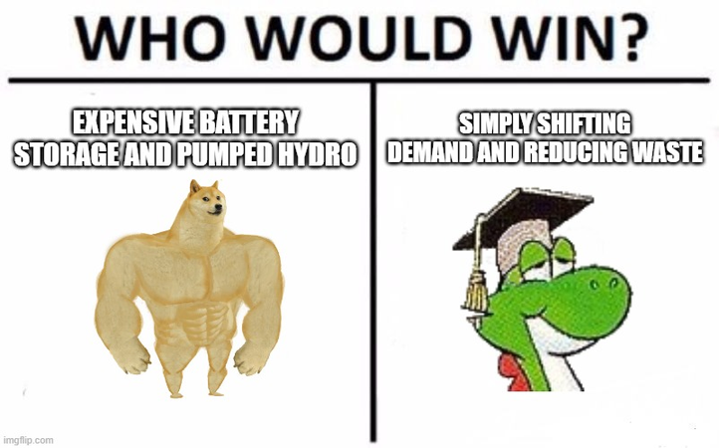
Time is Crucial
Energy Systems Refresher
DSM vs. Storage:
Storage shifts energy availability over time, DSM directly manages demand patterns to optimize energy usage
Image for illustration generated by a Python script
12
Notes:
Load Shifting:
Moving energy use from peak times to off-peak periods.
Balances demand, reduces strain on the grid, and lowers costs.
_______________
Efficiency Measures:
Reducing overall energy consumption without impacting performance.
Incorporates energy-efficient appliances, retrofits, and smarter usage practices.
_____________
Peak Shaving:
Minimising the highest peaks in energy demand.
Reduces the need for additional backup power and lowers operational costs.

Slide 13

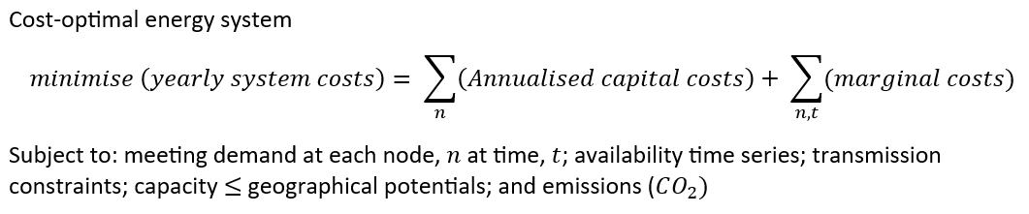
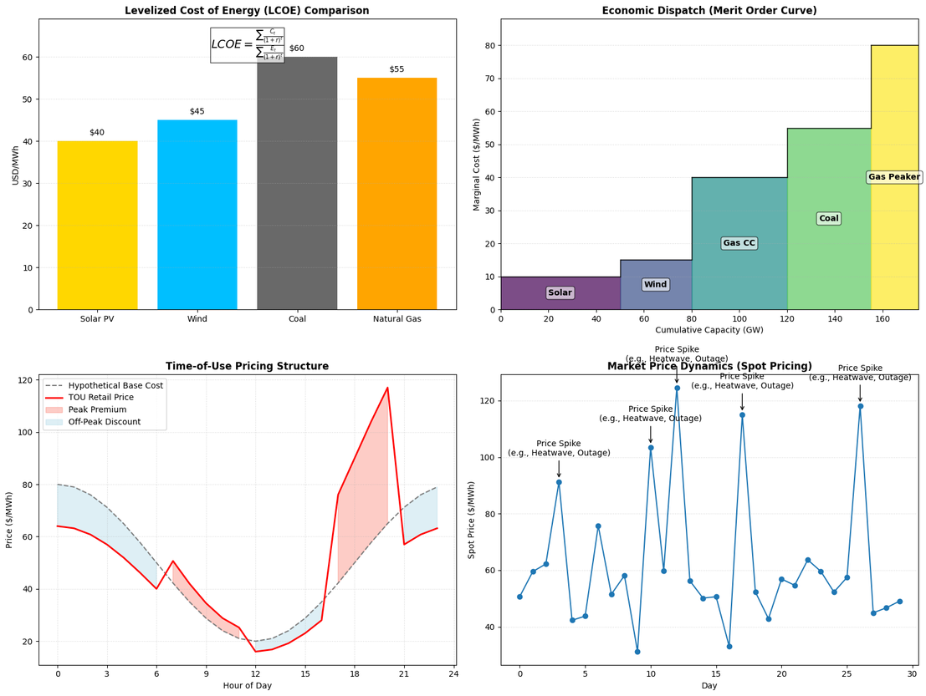
Energy Economics
Energy Systems Refresher
Cost of Energy Production:
Factors: Fuel costs, CAPEX, OPEX
Levelised Cost of Energy (LCOE)
Energy Pricing:
Influences: market structure, supply-demand dynamics, policies. Peak vs. off-peak pricing (time-of-use tariffs).
Economic Dispatch:
Optimising the generation mix to minimise costs while meeting demand.
Market Mechanisms:
Spot pricing, power purchase agreements (PPAs), and subsidies.
13
Image for illustration generated using a Python script

Slide 14
ESM
with
PyPSA
Step-by-Step
01_getting_started.ipynb: Introduces PyPSA. Covers basic network creation, adding time series and basic components.
02_components_basics.ipynb: Covers the basic components available in PyPSA and how to configure them.
03_network_visualization.ipynb: Covers how to visualise PyPSA networks using various plotting functions.
04_basic_optimization.ipynb: Covers basic network optimisation in PyPSA.
05_investment_planning.ipynb: Covers how to perform investment planning in PyPSA.
06_storage_and_balancing.ipynb: Covers how to model storage systems and demand-side management in PyPSA.
07_sector_coupling.ipynb: Covers how to model sector coupling in PyPSA and their interactions using coupling technologies (e.g., heat pumps, electrolyzers, and fuel cells).
08_diy_solar_simulation.ipynb: Demonstrates how PyPSA can model a small, real-life energy system, like a Solar Home System (SHS).
Jupyter Notebook Tutorials
https://github.com/tinegachris/ESM-Python-Nairobi/tree/main/notebooks/tutorials
Notes:
The Building Blocks (Mirroring Notebooks):
(Demo Start) Getting Started (01_getting_started.ipynb): We begin by importing PyPSA and creating an empty Network object – the main container for our model.
Adding Components (02_components_basics.ipynb): We'll define and add the fundamental building blocks:
Buses: The nodes of our network.
Generators: Representing power plants (e.g., coal, gas, wind).
Loads: Representing electricity demand.
Lines/Links: Connecting buses for power transmission.
Key Idea: Components are added using network.add() and their properties (like costs, capacities) are stored in pandas DataFrames within the network object (e.g., n.buses, n.generators). [fneum.github.io]
Visualizing (03_network_visualization.ipynb): We'll see how to plot the network to understand its structure, potentially overlaying it on a map.
Basic Optimization (04_basic_optimization.ipynb): Running a simple operational optimization (Optimal Power Flow - OPF) to see how PyPSA dispatches generators to meet load at least cost for a given time period.
Investment Planning (05_investment_planning.ipynb): Exploring how PyPSA can optimize investments – deciding how much capacity of each technology to build.
Storage & Balancing (06_storage_and_balancing.ipynb): Incorporating energy storage (like batteries) and handling the time-series challenges of balancing variable renewables and demand.
(Optional Mentions, depending on time/focus):
Sector Coupling (07_sector_coupling.ipynb): Briefly mention extending the model beyond electricity.
DIY Solar (08_diy_solar_simulation.ipynb): Showcasing custom component additions or specific analyses.
Let's Dive In:
We'll now switch to the notebooks and look at key code snippets and outputs for these steps.
(Transition): "Let's start with the first notebook, 01_getting_started.ipynb

Slide 15
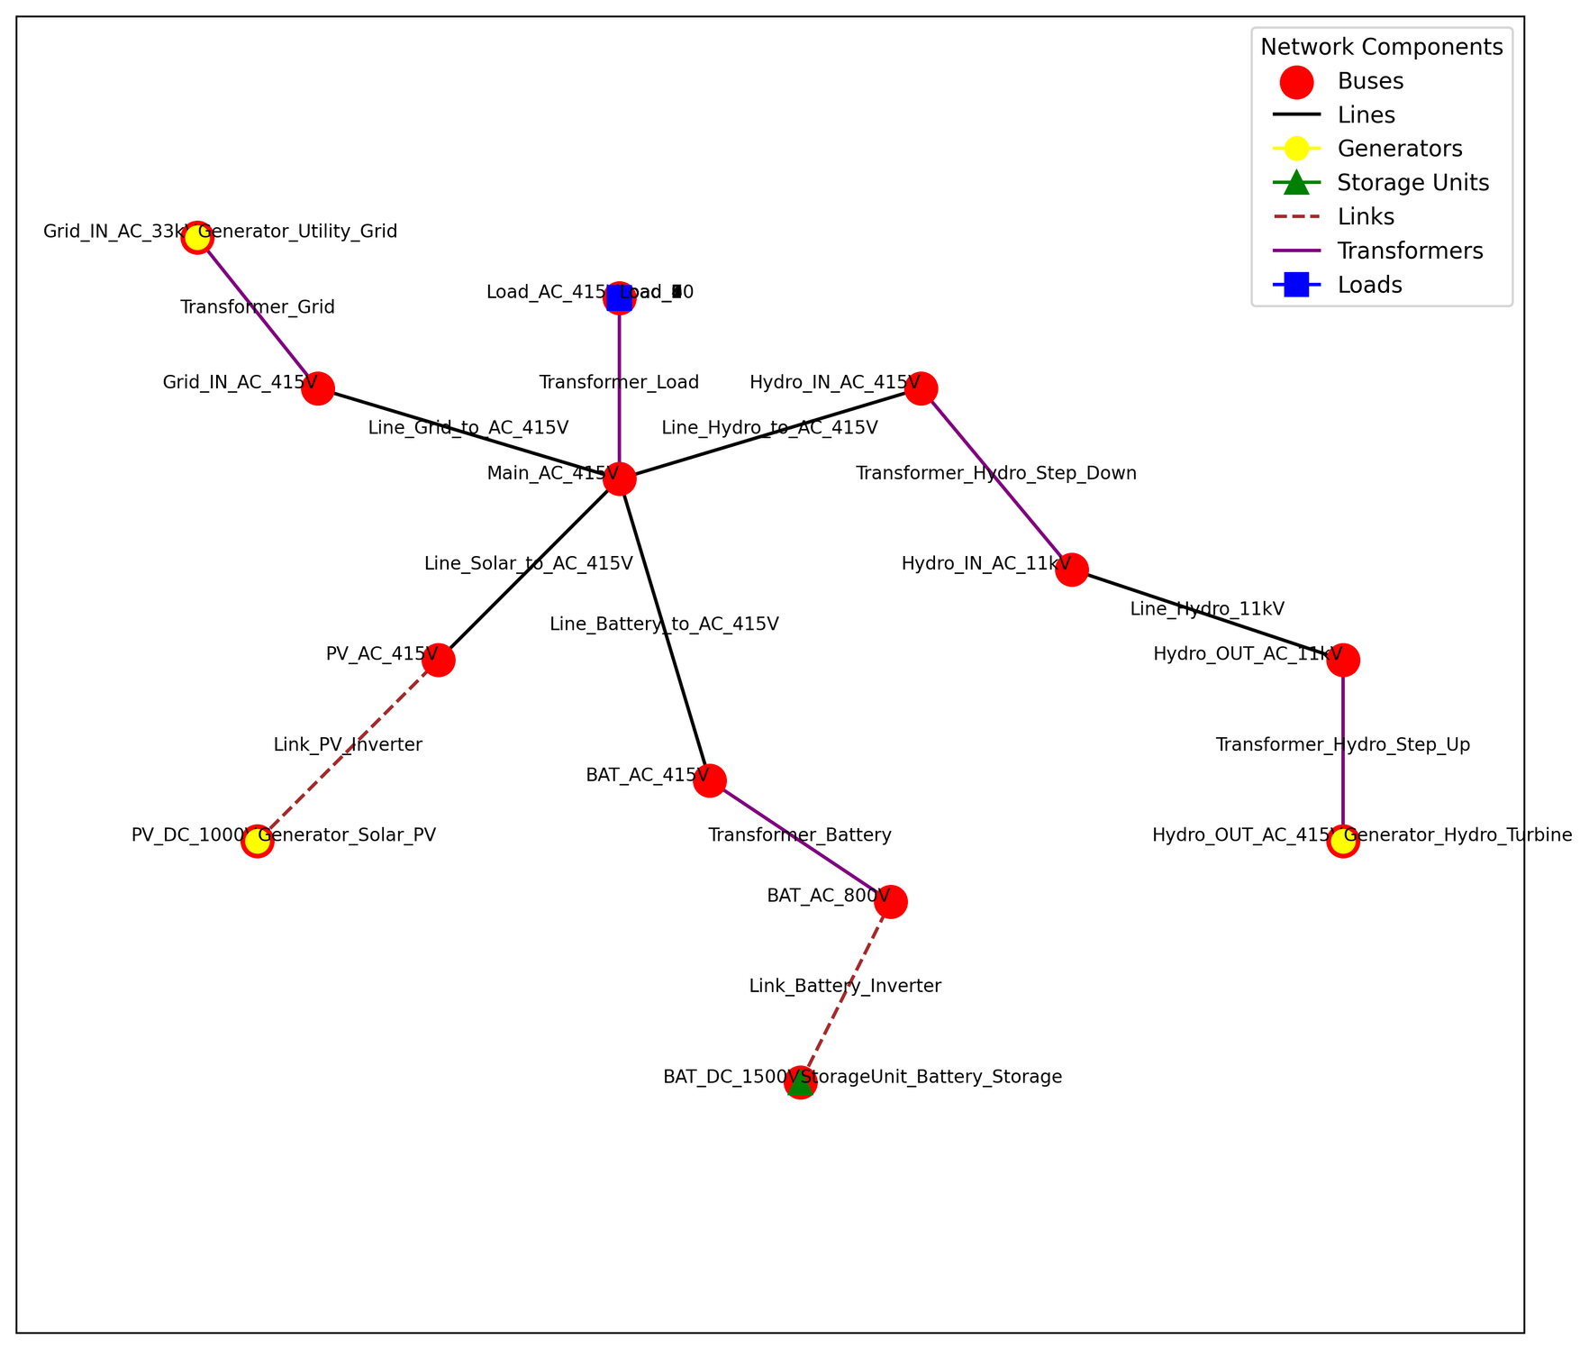

15

Slide 16
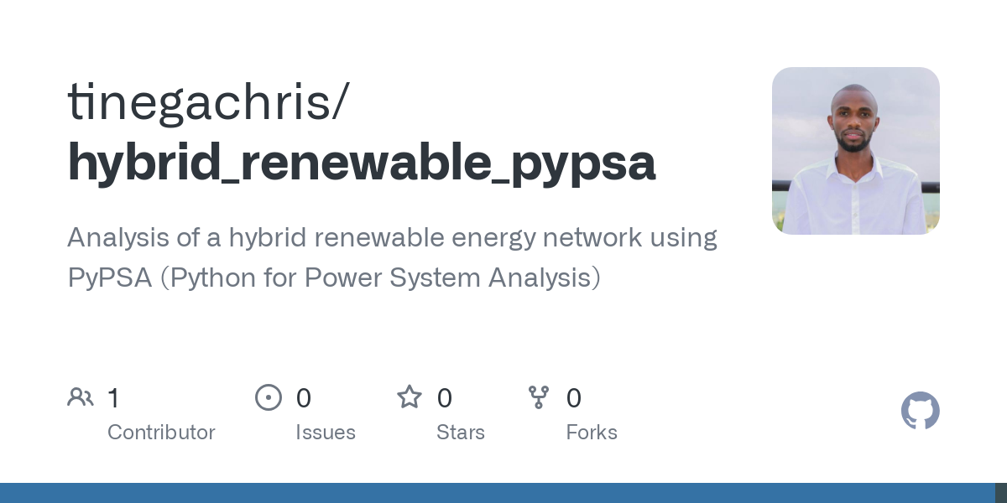

GitHub - tinegachris/hybrid_renewable_pypsa: Analysis of a hybrid renewable energy network using PyPSA (Python for Power System Analysis)
https://github.com/tinegachris/hybrid_renewable_pypsa
16

Slide 17
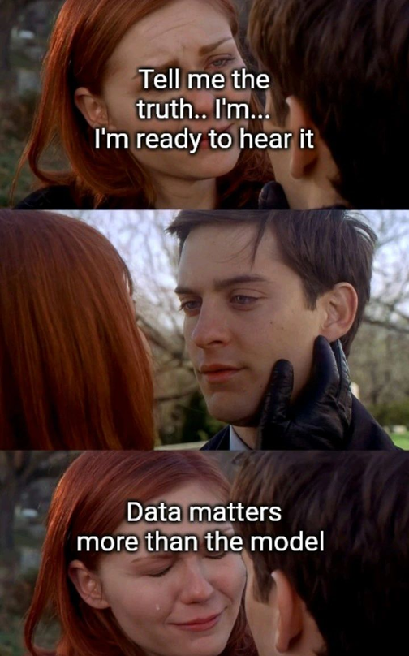

Practical Tips on Effective ESM
GIGO
Define your question first to define scope, complexity and resolution
Start simple; add complexity gradually
Understand model assumptions and limitations. How do they affect results?
Validate and sanity check
Leverage community resources
Choose the right tools

Slide 18
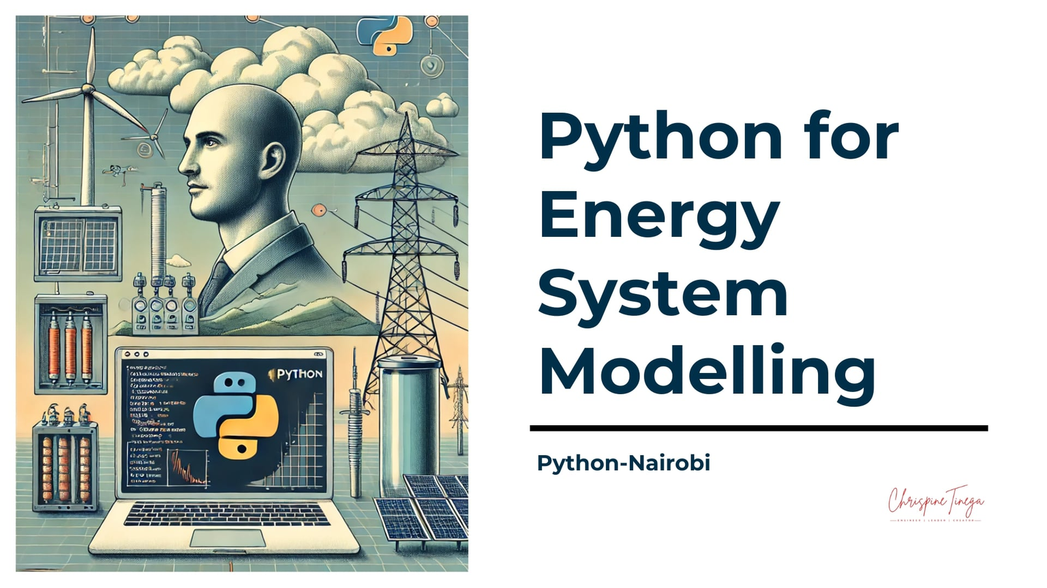
GitHub - tinegachris/ESM-Python-Nairobi: Documentation of Python for Energy System Modelling event hosted by Python Nairobi User Group.
https://github.com/tinegachris/ESM-Python-Nairobi
18

Slide 19

Continue Your Journey
PyPSA Documentation: The official guide, tutorials, examples, and API reference – https://pypsa.readthedocs.io/
Tom Brown's Energy Systems Modelling Course: Comprehensive university course materials covering PyPSA and general concepts – https://nworbmot.org/courses/
Fabian Neumann's Data Science for ESM Course: Focuses on data handling, analysis, and visualization in energy system modelling – https://fneum.github.io/data-science-for-esm/
Open Energy Modelling Wiki (Learning Materials): A curated list of diverse learning resources across the open energy modelling ecosystem – https://wiki.openmod-initiative.org/wiki/Learning_materials
Atlite Documentation: Crucial tool for converting weather data into time series for renewables and demand – https://atlite.readthedocs.io/
Linopy Documentation: The optimization modelling framework underpinning recent versions of PyPSA – https://linopy.readthedocs.io/
PyPSA-Eur: A large-scale, open model of the European transmission system – https://github.com/PyPSA/pypsa-eur
PyPSA-Africa: An open model focusing on the African continent's power system – https://github.com/PyPSA/pypsa-africa
OSeMOSYS (Main Website): A widely used framework for long-term energy system planning and integrated assessment – http://www.osemosys.org/
Starter Kits (Examples): Practical examples to kickstart energy modelling – https://climatecompatiblegrowth.com/starter-kits/
Open University Course: Online course to deepen your energy systems knowledge – https://www.open.edu/openlearncreate/course/view.php?id=6817
Open Energy Modelling Initiative Forum: A platform for discussions on all aspects of open energy modelling – https://forum.openmod-initiative.org/
Python Documentation: Official reference for the Python language – https://docs.python.org/3/
Google OR-Tools: Introduction to the optimization solvers these frameworks rely on – https://developers.google.com/optimization/introduction
19

Slide 20

Open Session
20
Notes:
That brings us to the end of the main presentation."
"We've seen the challenges facing our energy systems, how modeling helps us navigate them, and how Python tools like PyPSA provide a powerful, open-source environment for building and analyzing these models.
Prompting Discussion:
"Are there particular aspects of energy modeling in the Kenyan/African context that you think are most critical?"
"Has anyone here used other energy modeling tools, and how do they compare?"
"What opportunities do you see for using Python and open-source tools in the local energy sector?"

Slide 21








Thank You!
22

